Slide 1
Sentiment Analysis of Roman Urdu on E-Commerce Reviews Using Machine Learning
Bilal Chandio1, Asadullah Shaikh2, Maheen Bakhtyar1, Mesfer Alrizq2, Junaid Baber1, Adel Sulaiman2,*, Adel Rajab2 and Waheed Noor3 (2022)
Group Number: 01
21141064 Basit Hussain
RA: Sania Azhmee Bhuiyan
ST: Abid Hossain

Slide 2
Introduction
Advancements in e-commerce have changed business models.
Sentiment analysis plays a vital role in decision-making for vendors and customers in e-commerce.
Sentiment analysis of Roman Urdu comments on e-commerce reviews.

Slide 3
Objective
Extract Roman Urdu comments from e-commerce platforms
Annotate the comments based on expert opinions.
Train and evaluate machine learning and deep learning classifiers on the dataset

Slide 4
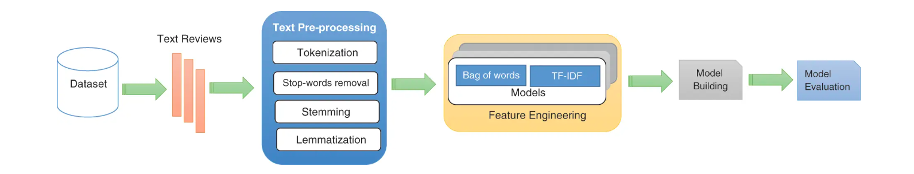
Methodology

Slide 5
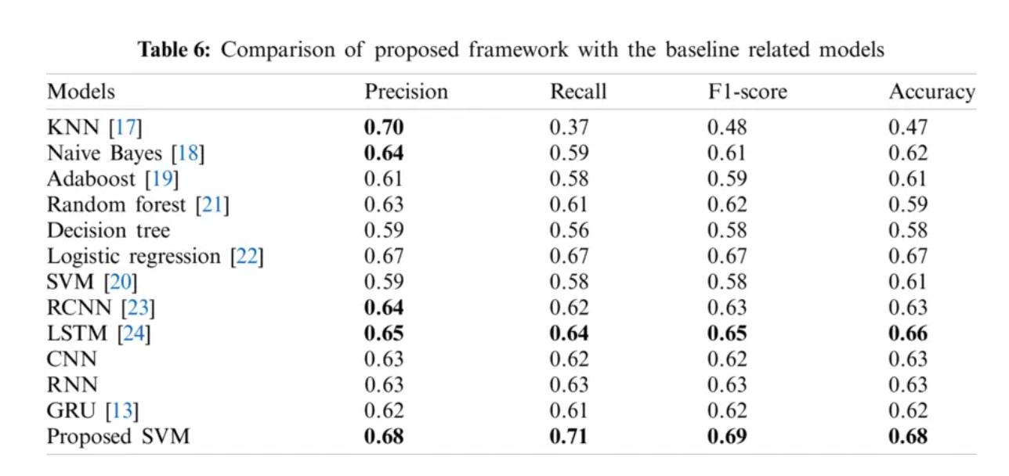
Results and Discussion
Performance Evaluation
Class-wise Accuracy
Comparative Analysis:

Slide 6
Conclusion
Roman Urdu sentiment analysis on e-commerce reviews is a challenging problem.
Proposed SVM approach with stemming achieved the highest accuracy of 68%.
SVM, Logistic Regression, and LSTM showed superior performance compared to other models.

Slide 7
Future Work
Extend the model for multilingual comments.
Include languages such as English and Urdu in sentiment analysis.

Slide 8
Thank you!

